Slide 1

Clustering Algorithms in Machine Learning
K-Means, Affinity Propagation, Mean Shift, Spectral Clustering,
Hierarchical, DBSCAN, OPTICS, BIRCH

Slide 2


Introduction to Clustering
Clustering is an unsupervised learning method.
Groups similar data points into clusters.
Used in market segmentation, anomaly detection, image processing.

Slide 3
Applications of Clustering
Market Segmentation
Social Network Analysis
Image Compression
Document Clustering
Fraud Detection
Bioinformatics

Slide 4
Types of Clustering Algorithms
1. Partitioning Methods (K-Means)
2. Propagation-Based (Affinity Propagation)
3. Centroid-Based (Mean Shift)
4. Graph-Based (Spectral Clustering)
5. Hierarchical Methods
6. Density-Based (DBSCAN, OPTICS)
7. Tree-Based (BIRCH)

Slide 5
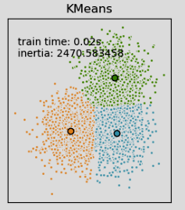
K-Means
Partitions data into K clusters.
Python:
from sklearn.cluster import KMeans
kmeans = KMeans(n_clusters=3).fit(X)
labels = kmeans.labels_
Pros: Simple, fast, scalable
Cons: Need K, sensitive to noise

Slide 6
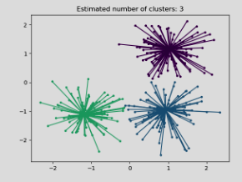
Affinity Propagation
Message-passing between points, no need to choose K.
Python:
from sklearn.cluster import AffinityPropagation
clust = AffinityPropagation().fit(X)
labels = clust.labels_
Pros: No need K, finds exemplars
Cons: High memory use, slower

Slide 7
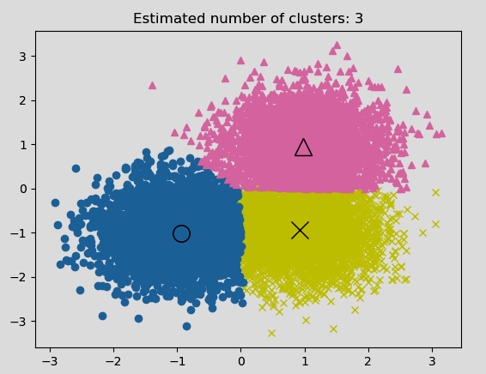
Mean Shift
Shifts centroids towards high-density regions.
Python:
from sklearn.cluster import MeanShift
ms = MeanShift().fit(X)
labels = ms.labels_
Pros: No need K, flexible shapes
Cons: Expensive on large data

Slide 8
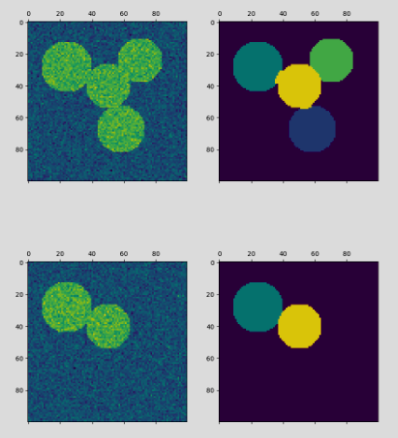
Spectral Clustering
Uses graph Laplacian and eigenvalues.
Python:
from sklearn.cluster import SpectralClustering
sc = SpectralClustering(n_clusters=3).fit(X)
labels = sc.labels_
Pros: Works on non-convex clusters
Cons: Expensive on large datasets

Slide 9
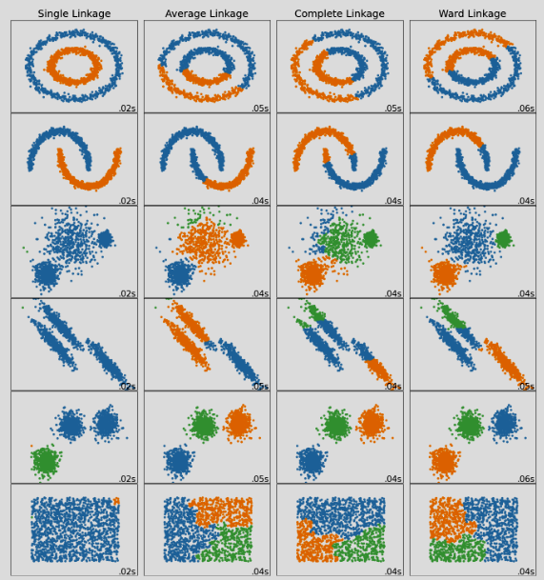
Hierarchical Clustering
Agglomerative/Divisive approaches with dendrogram.
Python:
from scipy.cluster.hierarchy import linkage, dendrogram
Z = linkage(X, 'ward')
Pros: No need K, interpretable
Cons: Expensive for big data

Slide 10
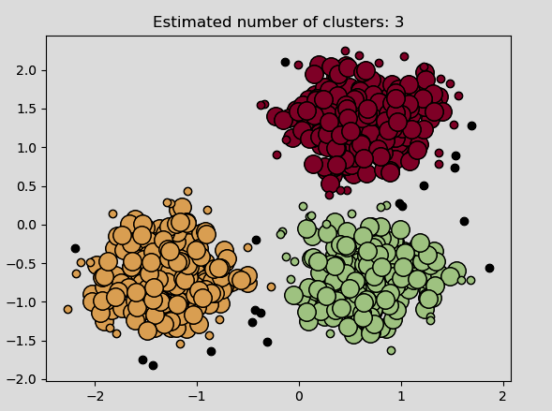
DBSCAN
Groups points with many neighbors, detects noise.
Python:
from sklearn.cluster import DBSCAN
db = DBSCAN(eps=0.5, min_samples=5).fit(X)
labels = db.labels_
Pros: Arbitrary shapes, noise handling
Cons: Struggles with varying density

Slide 11
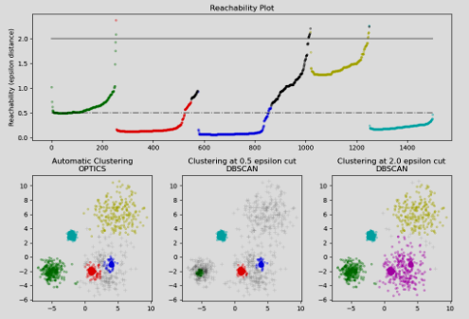
OPTICS
Orders points to handle varying density.
Python:
from sklearn.cluster import OPTICS
opt = OPTICS(min_samples=5).fit(X)
labels = opt.labels_
Pros: Handles varying density
Cons: Slower than DBSCAN

Slide 12
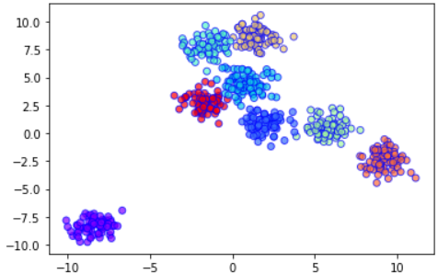
BIRCH
Tree structure (CF Tree) for large datasets.
Python:
from sklearn.cluster import Birch
brc = Birch(n_clusters=3).fit(X)
labels = brc.labels_
Pros: Scales to large data
Cons: Works best with spherical clusters

Slide 13
Comparison of Clustering Algorithms
K-Means: Fast, needs K, sensitive to noise
Affinity Propagation: No K, slower, memory heavy
Mean Shift: Flexible, expensive
Spectral: Good for non-convex, expensive
Hierarchical: Dendrogram, expensive for large data
DBSCAN: Arbitrary shapes, struggles with varying density
OPTICS: Handles varying density, slower
BIRCH: Scales well, works best on spherical clusters

Slide 14
Conclusion
Clustering groups data without labels.
Many algorithms exist, each with trade-offs.
Choice depends on data size, shape, density, and noise.
No single best algorithm for all problems.

